Slide 1
Movie Poster Pictograms
By Carol Francesconi

Slide 2
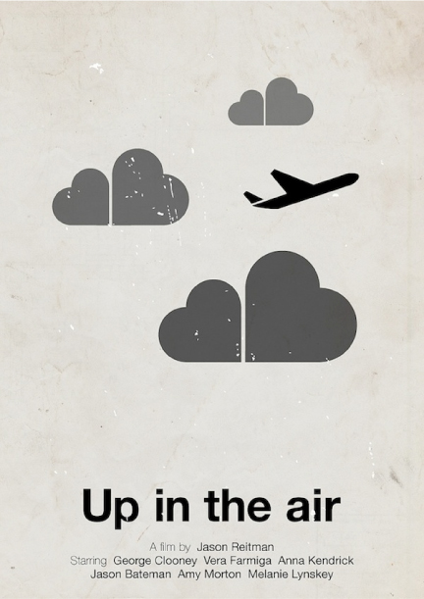
inspiration
Our assignment was to simplify a movie poster into pictographs.

Slide 3


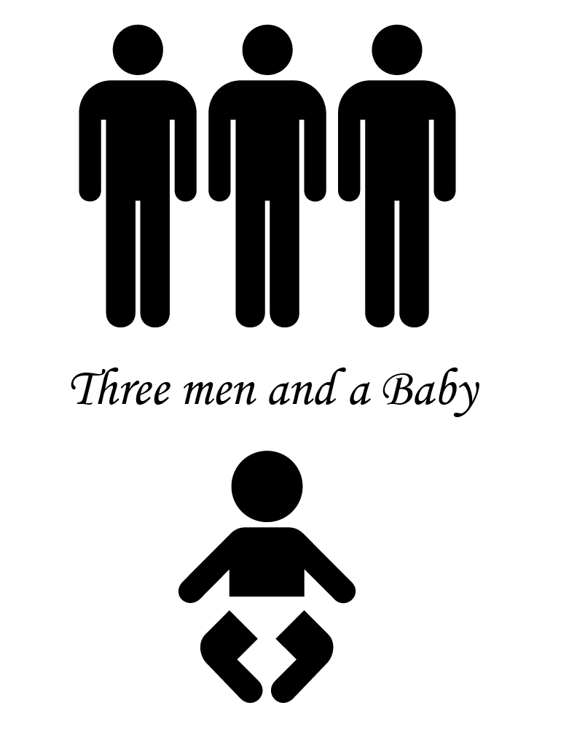



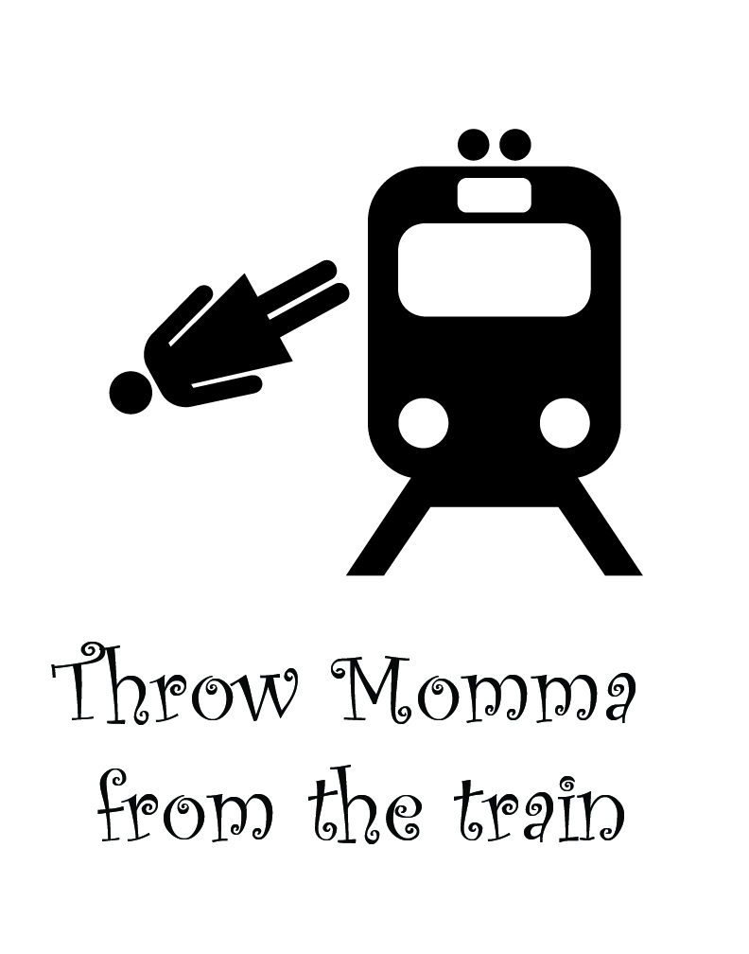
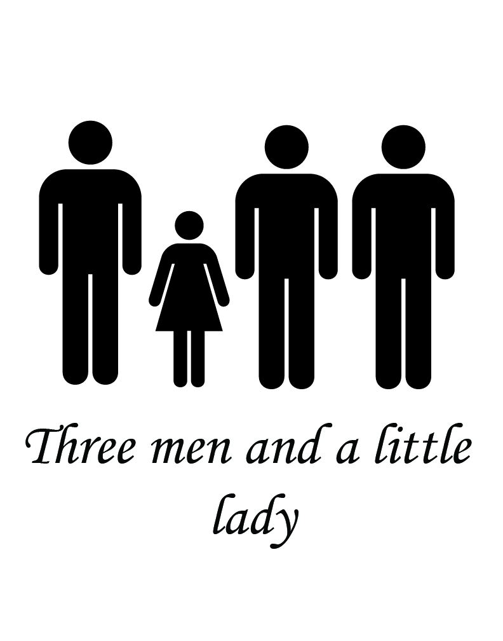

BOGGED DOWN
Too many ideas
I didn’t stop and read the directions. So I spent a bit of time finding more pictographs. Had a lot of fun and came up with 25 movie poster ideas.

Slide 4



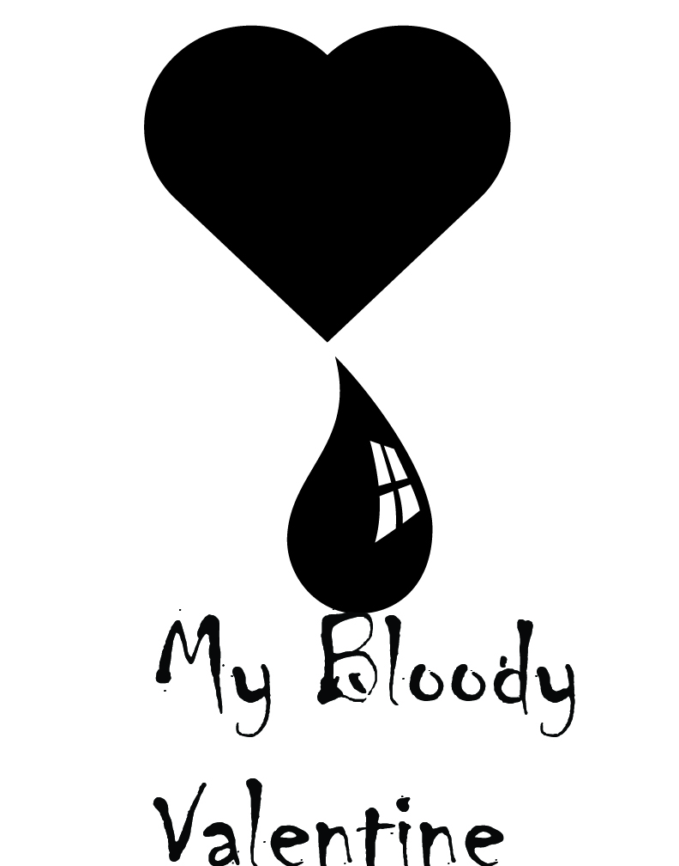





Not quite right
I soon realized that many of my ideas were more like Pictionary subjects than actually informing a viewer of what the movie is about.

Slide 5







The next step
Realizing I wanted more that just a Pictionary poster, I went though and found the images that I felt had the most promise. I found four that I thought I could improve on.

Slide 6
Overboard

Slide 7
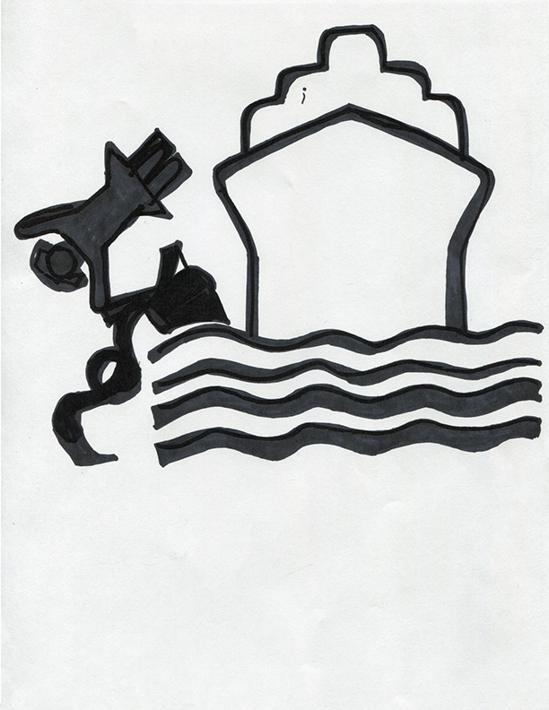
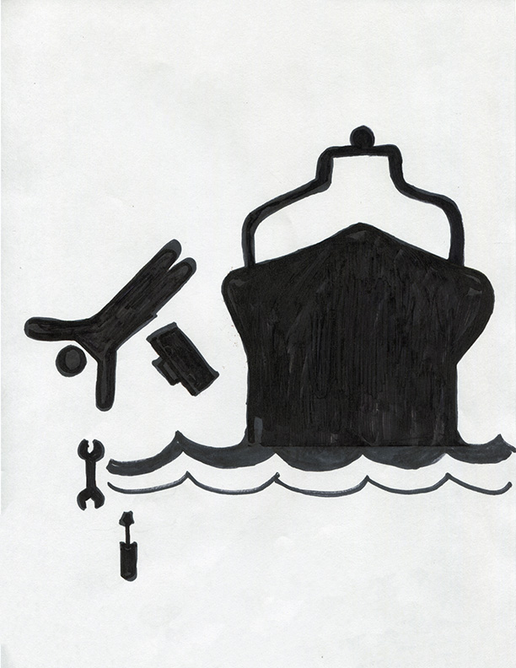
Not inspired
Overboard was the first to go. Although there were ideas of placing the person in the water, not just falling and adding a second person on the boat, this poster just didn’t read as clearly as I wanted so I moved on to the other posters.

Slide 8
Sharknado

Slide 9
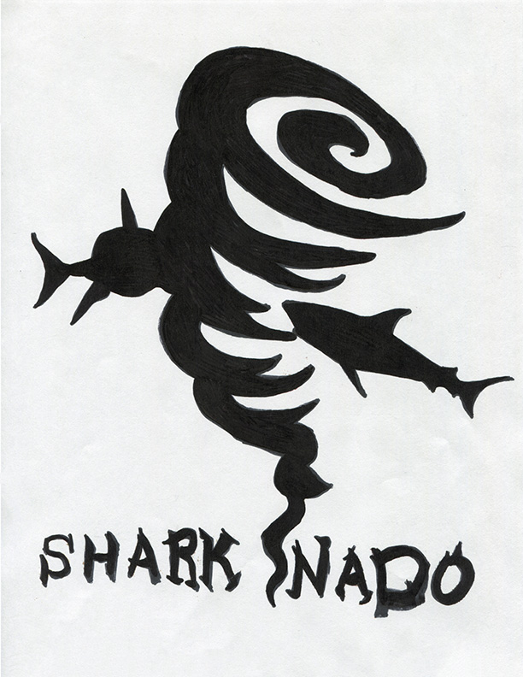
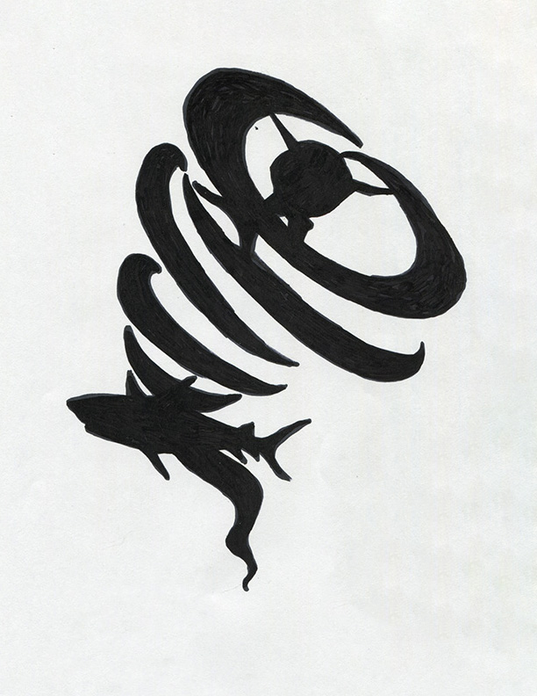
Finding the middle ground
Both of these Sharknado sketches had elements that I really liked. So I took elements from both to create my final poster.

Slide 10

Creating Sharknado
The tornado image was one of my own sketch. I then traced the top of the vortex with the pen tool and then reused the swooping arm to continue to create the rest of the funnel adjusting the size and angles. Then I merged the layers. The Sharks were actual images of sharks that were also traced with the pen tool. To bring the shark in the top of the vortex forward I added a white shark shape behind to give definition, also adding white lines at the tail.

Slide 11
Wolf of Wallstreet

Slide 12
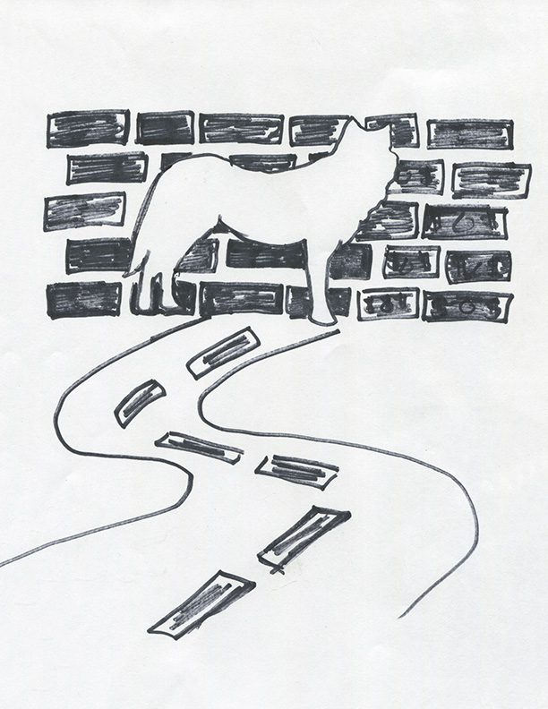
Using negative space
I really liked the concept of using the lack of an outline with the wolf. To accomplish this I had to make sure that the background was densely populated with information so that I could remove the outline from the wolf. The road and the wall were both a little too “Pictionary” and I need to find a way to say more about the movie. I had originally intended to use dollar bills instead of bricks and I was encouraged to explore that avenue further.

Slide 13
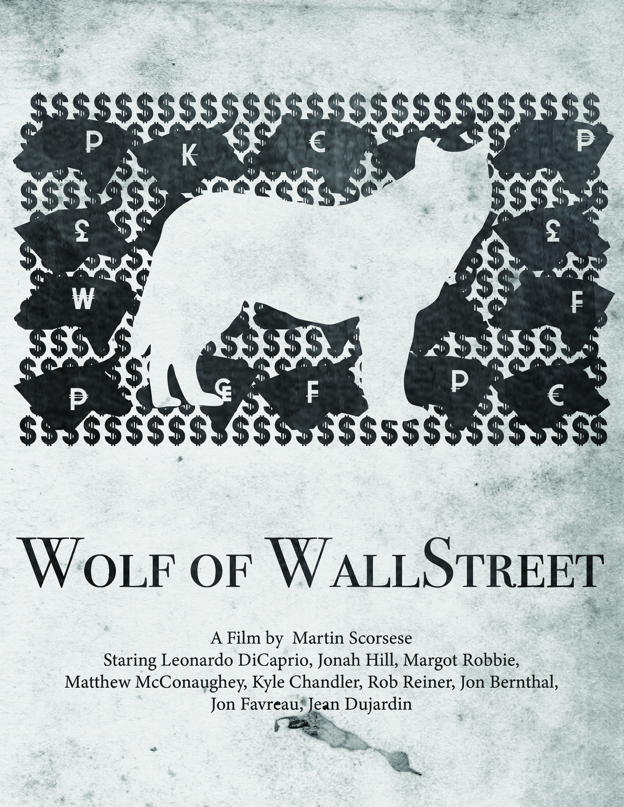
Finding the right backing
Just covering the background in $ might have been enough but when I really started to think about what kind of things would tell someone what this was a movie about I decided to add the Bull, the Bear, and other currency symbols. With more time, trying to M.C. Escher this background would be awesome.
These images were created using the pen tool and the image trace tool.

Slide 14
The Parent Trap

Slide 15
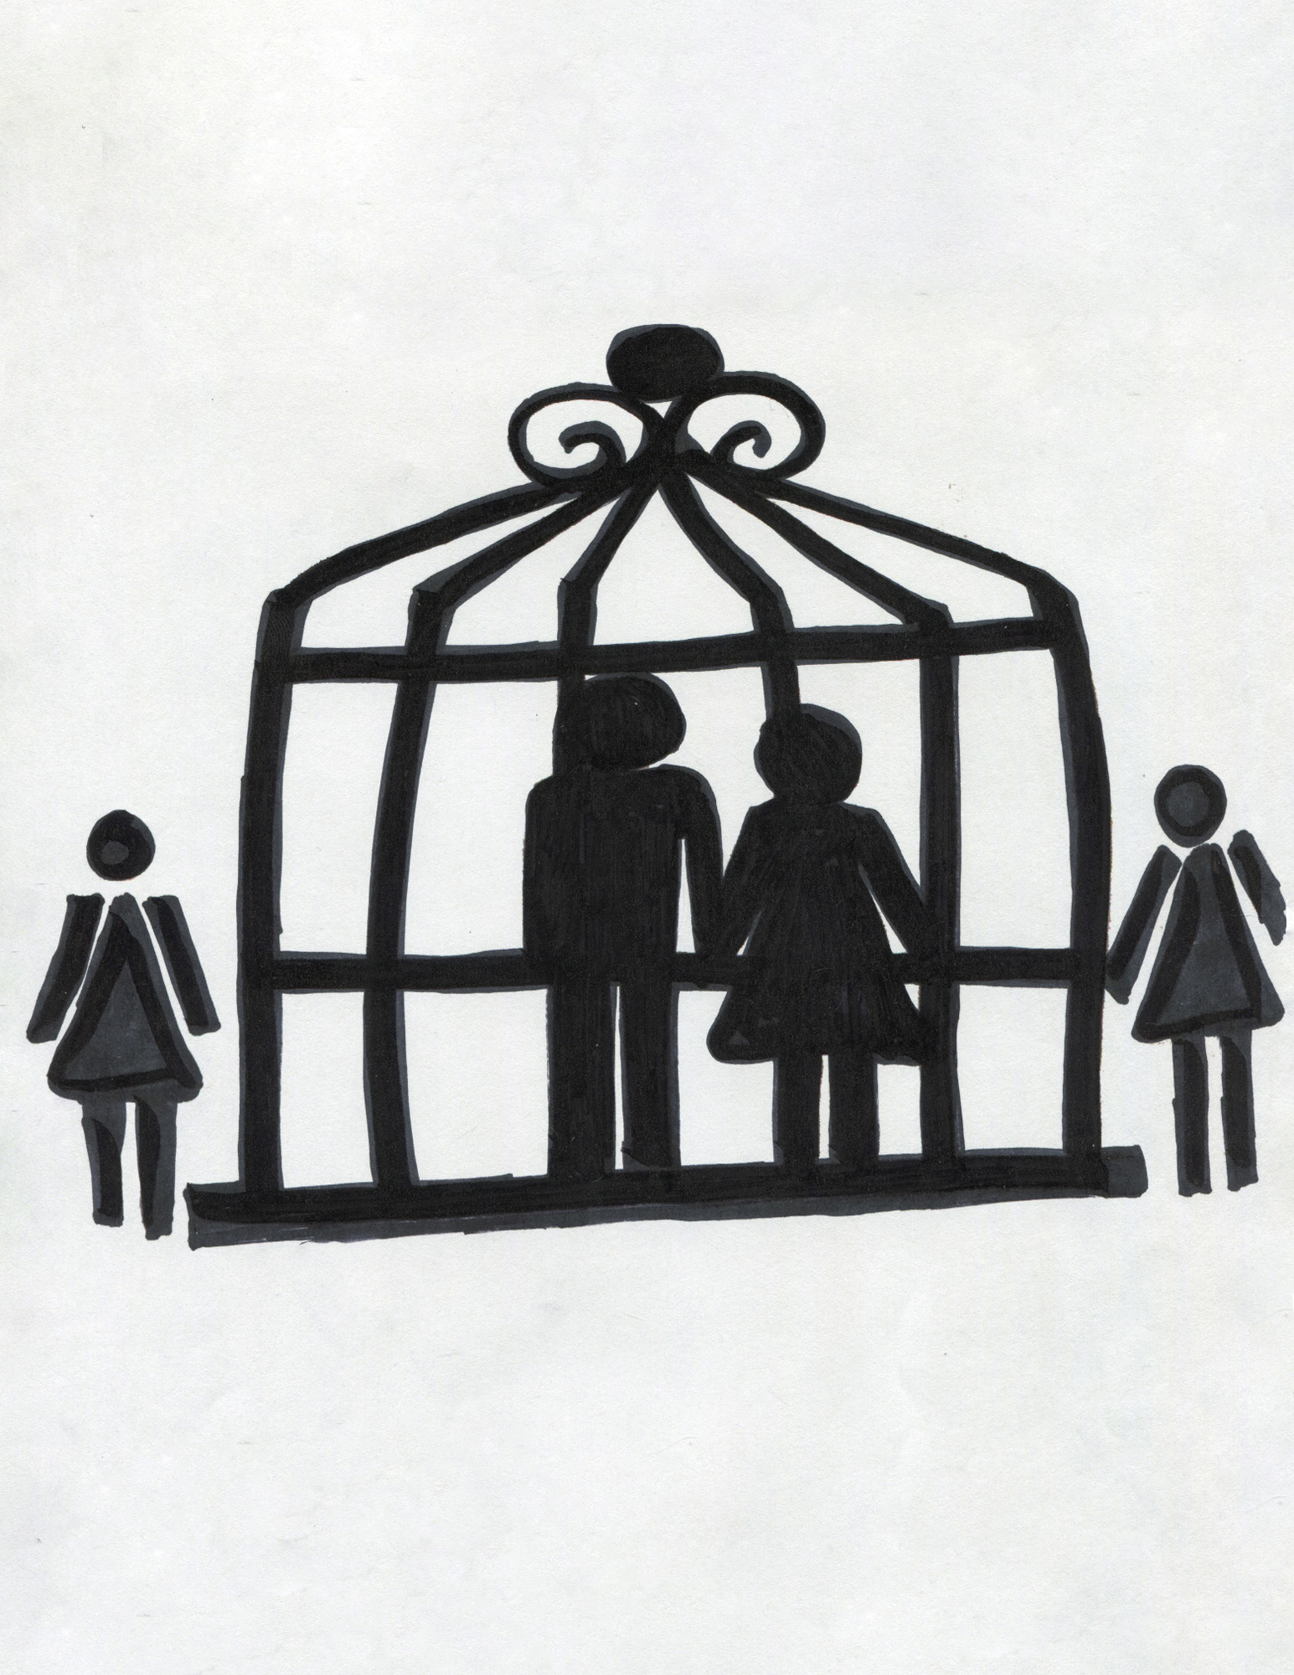
Saying it the right way
I thought that my original idea was a little too “lost in the woods and fell in a pit trap”. So I tried cuter. While this was cute it was pointed out to me that it didn’t read as “trap” and that the little girls could have been jailers or guards.

Slide 16
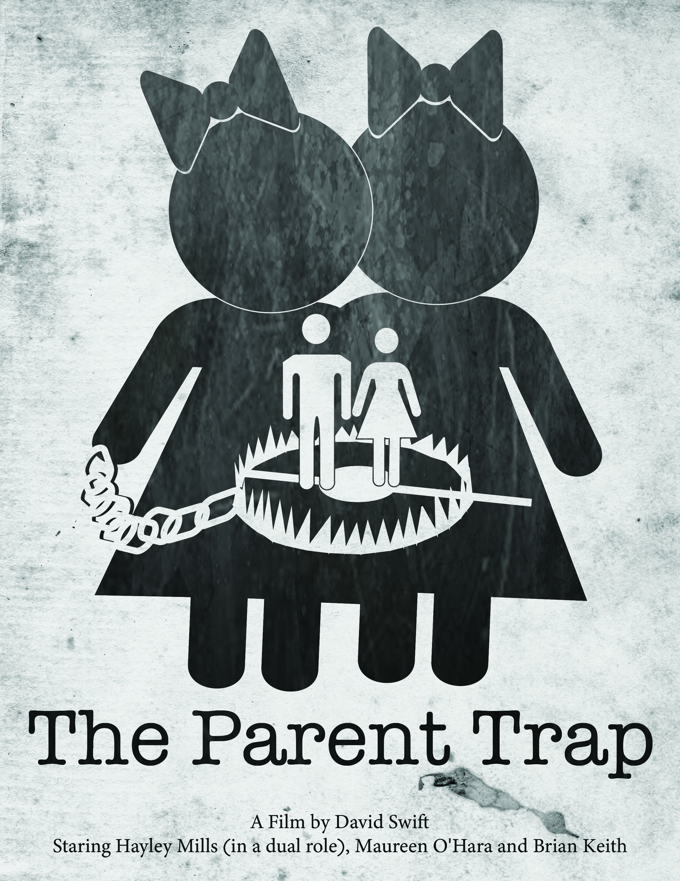
Now it says it…
So I took the advice I was given and made sure you could tell that they were little girls and that the parents were in a trap. But after all that I realized that I had missed the mark and that this did NOT read as a wholesome family show but as something more akin to the shining…

Slide 17

Try again
Once again taking pieces from more than one earlier sketch and working them together brought me to an end product that I feel reads correctly.
The images in this poster were created using the steps in the tutorial from class.

Slide 18
All the same
All of the final images have 3 textures
The white paper
A black chalkboard
A black water marked
TO do this a clipping mask was made in Photoshop.
Everything else was done with the images was done in illustrator.

